Slide 1





Curious Minds Award 2026/27
Log of Evidence
Platinum Award
Add School Name
Notes:
·This Log of Evidence demonstrates that you have completed the work you’ve described in the application form and provides an account of the hands-on, STEM work carried out by learners in your school.
·This year, your log of evidence must be presented using the SFI Curious Minds Log of Evidence Template.
·Images or videos providing evidence of each activity should be added to the Log of Evidence Template, labelled and uploaded to the online application platform SESAME in PDF or PowerPoint format. The template slides can be edited in PowerPoint or Google Slides and additional slides may be added.
·All evidence should represent the learners’ hands-on STEM work and include clearly labelled photos/ videos/projects/learner’s written accounts (Teacher write-ups and lesson plans are not accepted).
Note: Please check your application to ensure that all links and files are easily accessible and clearly labelled before submitting. We may return your application if it is not well organised or not clearly labelled.

Slide 2
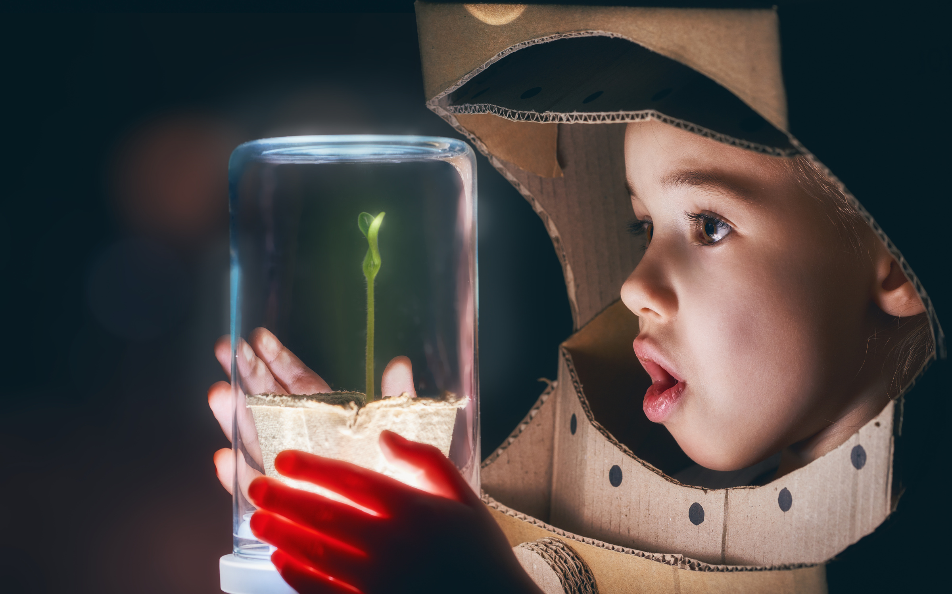


Step 1: Science
Notes:
STEP 1 Science
Provide evidence of the learners engaging in science activities in school or online.
One hands-on investigation from each of the following curriculum strands (four in total):
• Living things
• Energy and forces
• Materials
• Environmental awareness and care or Nature of STEM

Slide 3
Living Things
Platinum Award
Step 1: Science

Slide 4
Energy and Forces
Platinum Award
Step 1: Science

Slide 5
Materials
Platinum Award
Step 1: Science

Slide 6
Environmental Awareness and Care ​
OR​
Nature of STEM​
Platinum Award
Step 1: Science

Slide 7
Science Activity 1
Platinum Award
Step 1: Science

Slide 8
Science Activity 2
Platinum Award
Step 1: Science

Slide 9
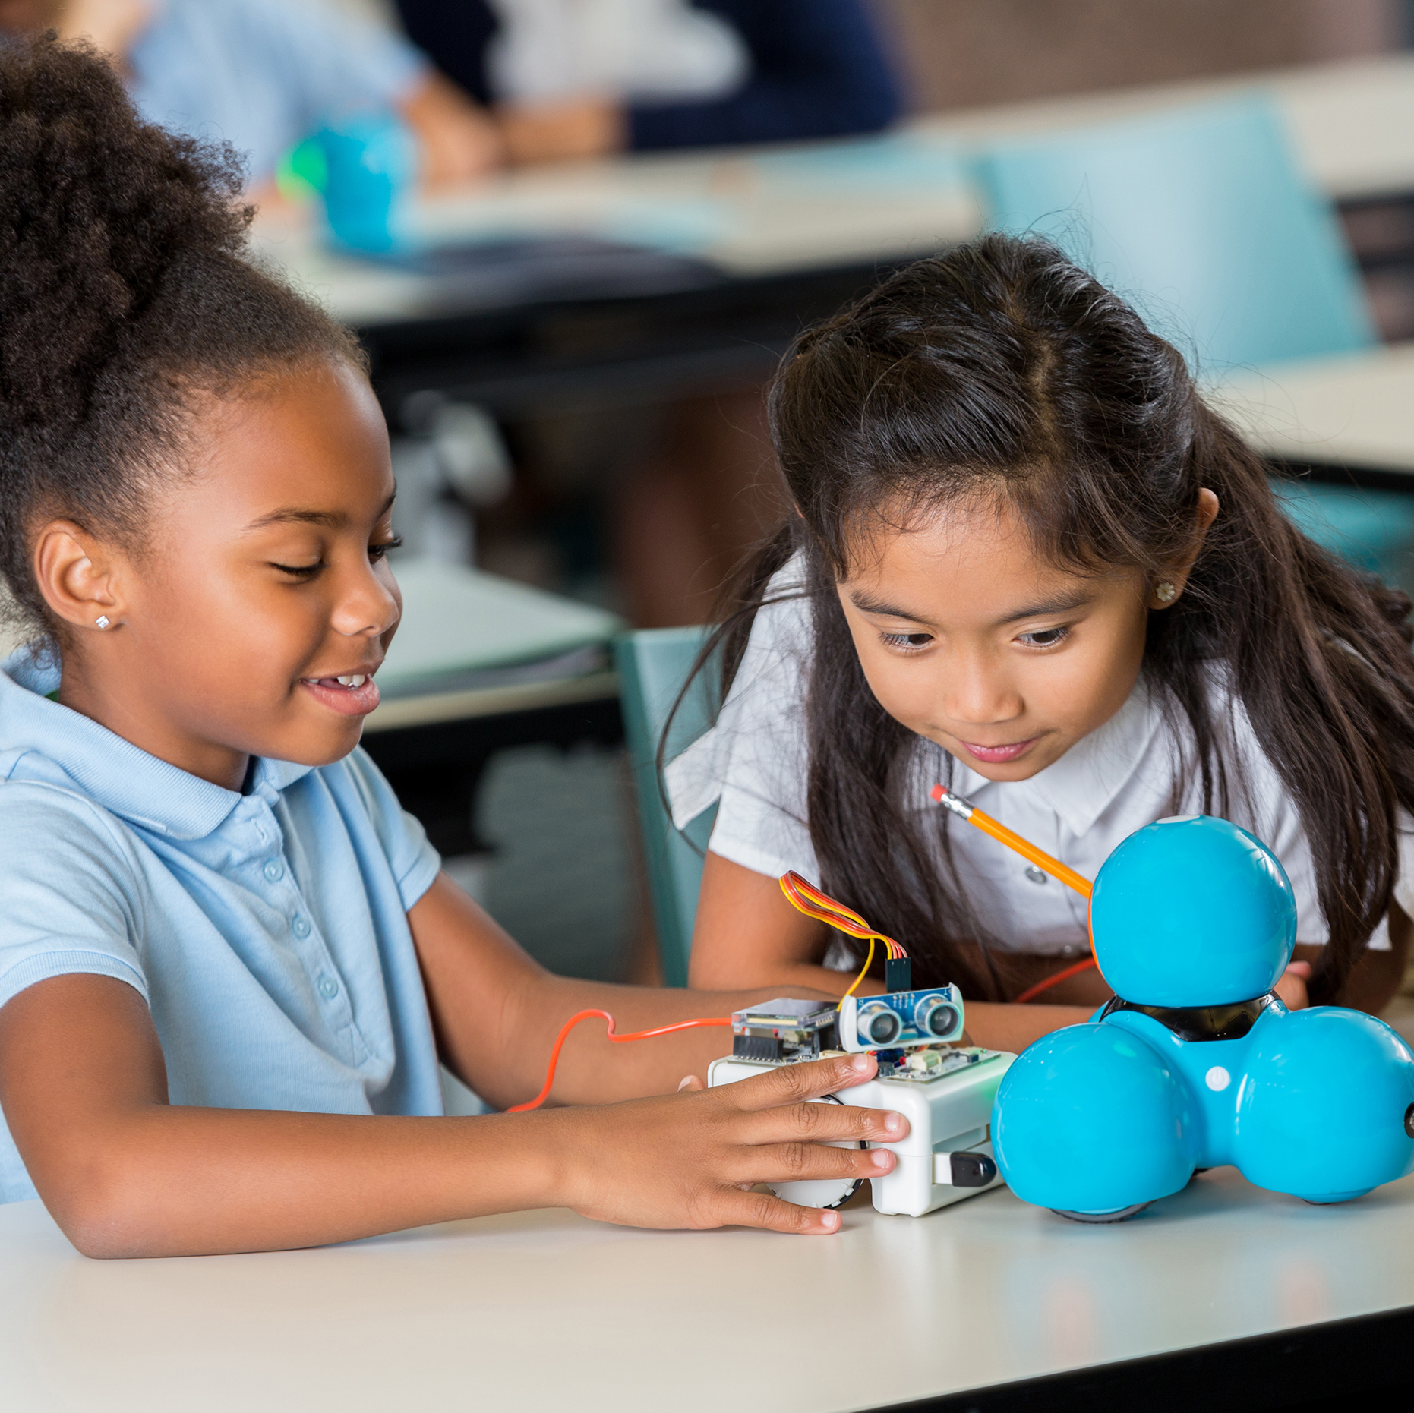

Step 2: Technology
Notes:
For step 2, we need to see that your learners are using technology in schoolwork, specifically information communications technologies (ICT), coding, robotics.
For the Platinum Award, schools must show evidence of one or more example of learners using technology in school.
Example activities:
Record and analyse data using a medium like a spreadsheet or graph.
Develop a blog, website or video.
Use electronic components to build circuit.
Take part in coding and computer science initiatives. Examples include National Scratch Competition, Hour of Code and EU Code Week.
Explore robotics. Examples include First Lego League.
Engage pupils in game-based learning through games such as Minecraft.
Use microscopes during investigations.
Participate in Tech Week.
Explore renewable energy technologies, for example using a solar energy kit

Slide 10
First Activity
Platinum Award
Step 2: Technology

Slide 11
Second Activity
Platinum Award
Step 2: Technology

Slide 12
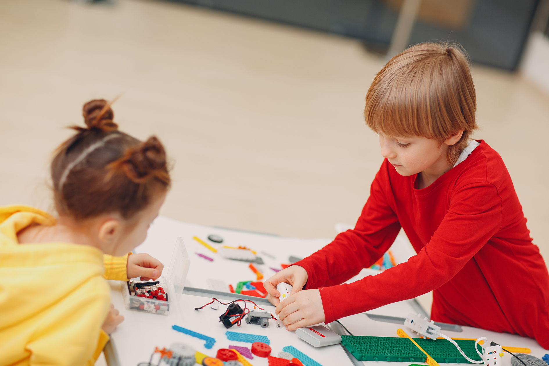

Step 3: Engineering
Notes:
For step 3, we need to see how your learners investigate engineering in the classroom, your local area and beyond.
For the Platinum Award, schools must show evidence of one or more example of learners investigating engineering.
Examples activities:
Plan, design, make and test a model such as a bridge, boat, rocket, water pump or catapult.
Investigate the engineering of something in your local area, such as a bridge, factory or wind farm.
Investigate and develop an understanding of how everyday items, such as bicycle gears, work.
Organise an event during Engineers Week.
Use the Engineers Week classroom pack.

Slide 13
Platinum Award
Step 3: Engineering First Activity

Slide 14
Platinum Award
Step 3: Engineering Second Activity

Slide 15


Step 4: Maths
Notes:
For step 4, we need to see how your learners apply their maths knowledge and skills in practical ways.
For the Platinum Award, schools must show evidence of one or more example of learners applying their maths knowledge and skills in practical ways.
Examples activities:
Use maths skills as part of Science, Technology and Engineering.
Apply maths skills during activities such as baking or gardening. This might include ordering, measuring and analysing data using maths operations such as ratios, percentages and averages.
Use Maths to record and analyse science investigation results.
Take part in Maths Week.
Develop a Maths trail around the school.
Use Maths to explore and help solve real-world problems.

Slide 16
Platinum Award
Step 4: Maths First Activity

Slide 17
Platinum Award
Step 4: Maths Second Activity

Slide 18

Step 5: Show and Tell

Slide 19
Platinum Award
Step 5: STEM Show and Tell

Slide 20

Platinum Award Reflections
Notes:
Towards the end of the project period, participating schools are required to gather reflections or feedback from all three target groups (learners, teachers and parents) about what has changed or improved as a result of the work undertaken.
Feedback and reflections can be gathered from learners, teachers and parents using a series of questions in surveys or interviews (written, recorded or filmed), or at open days or STEM showcases in the school. Some schools gather parent’s reflections via email.

Slide 21
Platinum Award
Reflections - Learners​

Slide 22
Platinum Award
Reflections - Teachers​

Slide 23
Platinum Award
Reflections - Parents​

