Slide 1

Curious minds award 2025 2026
Curious Minds Award 2025/26
Log of Evidence
Silver Award
Add School Name
Notes:
This Log of Evidence demonstrates that you have completed the work you’ve described in the application form and provides an account of the hands-on, STEM work carried out by learners in your school.
This year, your log of evidence must be presented using this SFI Curious Minds Log of Evidence Template.
Images or videos providing evidence of each activity should be added to the Log of Evidence Template, labelled and uploaded to the online application platform SESAME in PDF or PowerPoint format. The template slides can be edited in PowerPoint or Google Slides and additional slides may be added.
All evidence should represent the learners’ hands-on STEM work and include clearly labelled photos/ videos/projects/learner’s written accounts (Teacher write-ups and lesson plans are not accepted).
Note: Please check your application to ensure that all links and files are easily accessible and clearly labelled before submitting. We may return your application if it is not well organised or not clearly labelled.
For the Silver Award Participation must involve a minimum of two classes. The criteria can be split between participating classes.

Slide 2
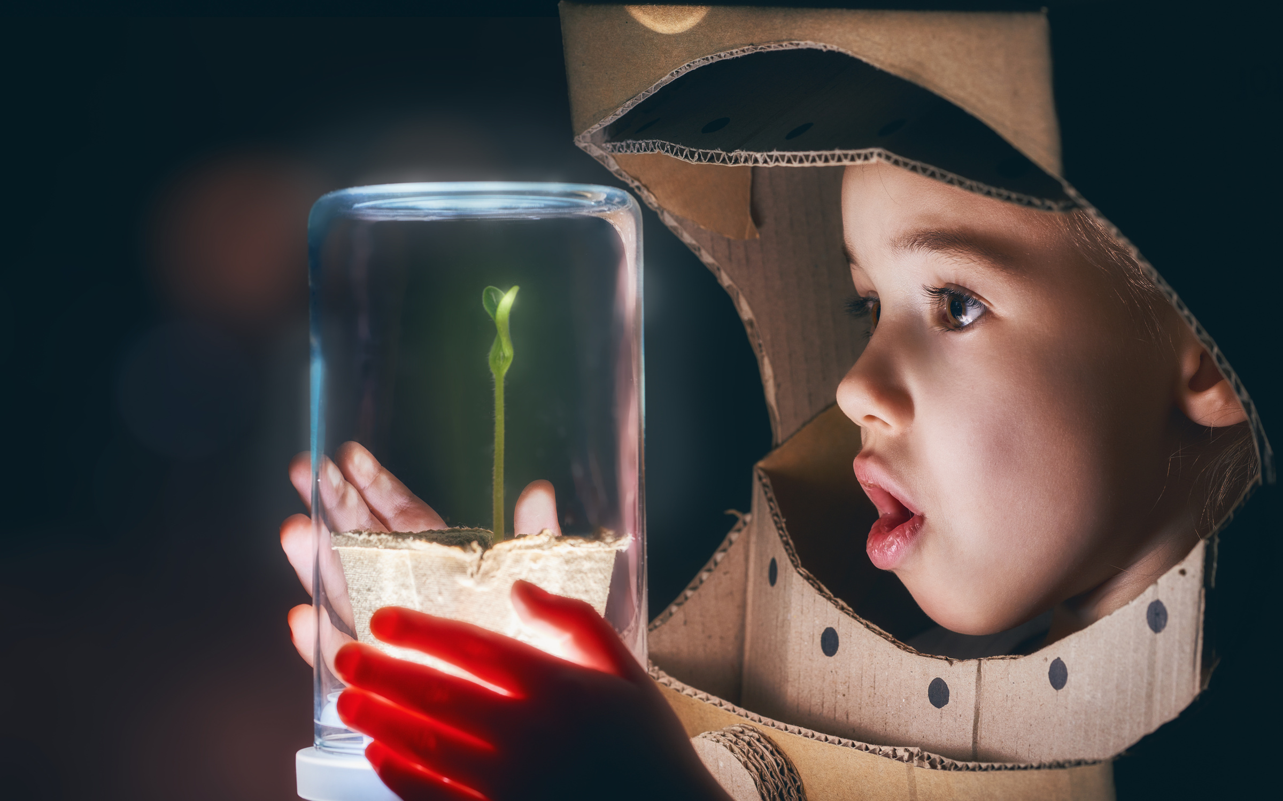

Step 1: Science
Notes:
STEP 1 Science
Provide evidence of the learners engaging in science activities in school or online.
One hands-on investigation from each of the four curriculum strands (four in total):
• Living things
• Energy and forces
• Materials
• Environmental awareness and care

Slide 3
First Investigation
Silver Award
Step 1: Science
Provide evidence for the first of three hands-on Science investigations carried out by learners. This can be chosen from any of the four strands in the science curriculum (Living Things, Energy and Forces, Materials, Environmental Awareness and Care). Label clearly below.
Label
Notes:
Provide evidence for three examples of hands-on science investigations from any of the four curriculum strands Living things; Energy and forces; Materials; Environmental awareness and care.
You and the students can come up with your own ideas or use our classroom activities guide on www.curiousminds.ie, ESERO Ireland activities www.esero.ie/primary-level, or any other resources available to you. Virtual speakers (live online via Skype, Zoom, Teams etc.), online workshops (must be live) and digital engagement (participation in hands-on investigations remotely) will be accepted as evidence.
These must be documented through photos, students’ accounts or projects.

Slide 4

Second Investigation
Silver Award
Step 1: Science
Provide evidence for the second of three hands-on Science investigations carried out by learners. This can be chosen from any of the four strands in the science curriculum (Living Things, Energy and Forces, Materials, Environmental Awareness and Care). Label clearly below.
Label

Slide 5
Third Investigation
Silver Award
Step 1: Science
Provide evidence for the third of three hands-on Science investigations carried out by learners. This can be chosen from any of the four strands in the science curriculum (Living Things, Energy and Forces, Materials, Environmental Awareness and Care). Label clearly below.
Label

Slide 6
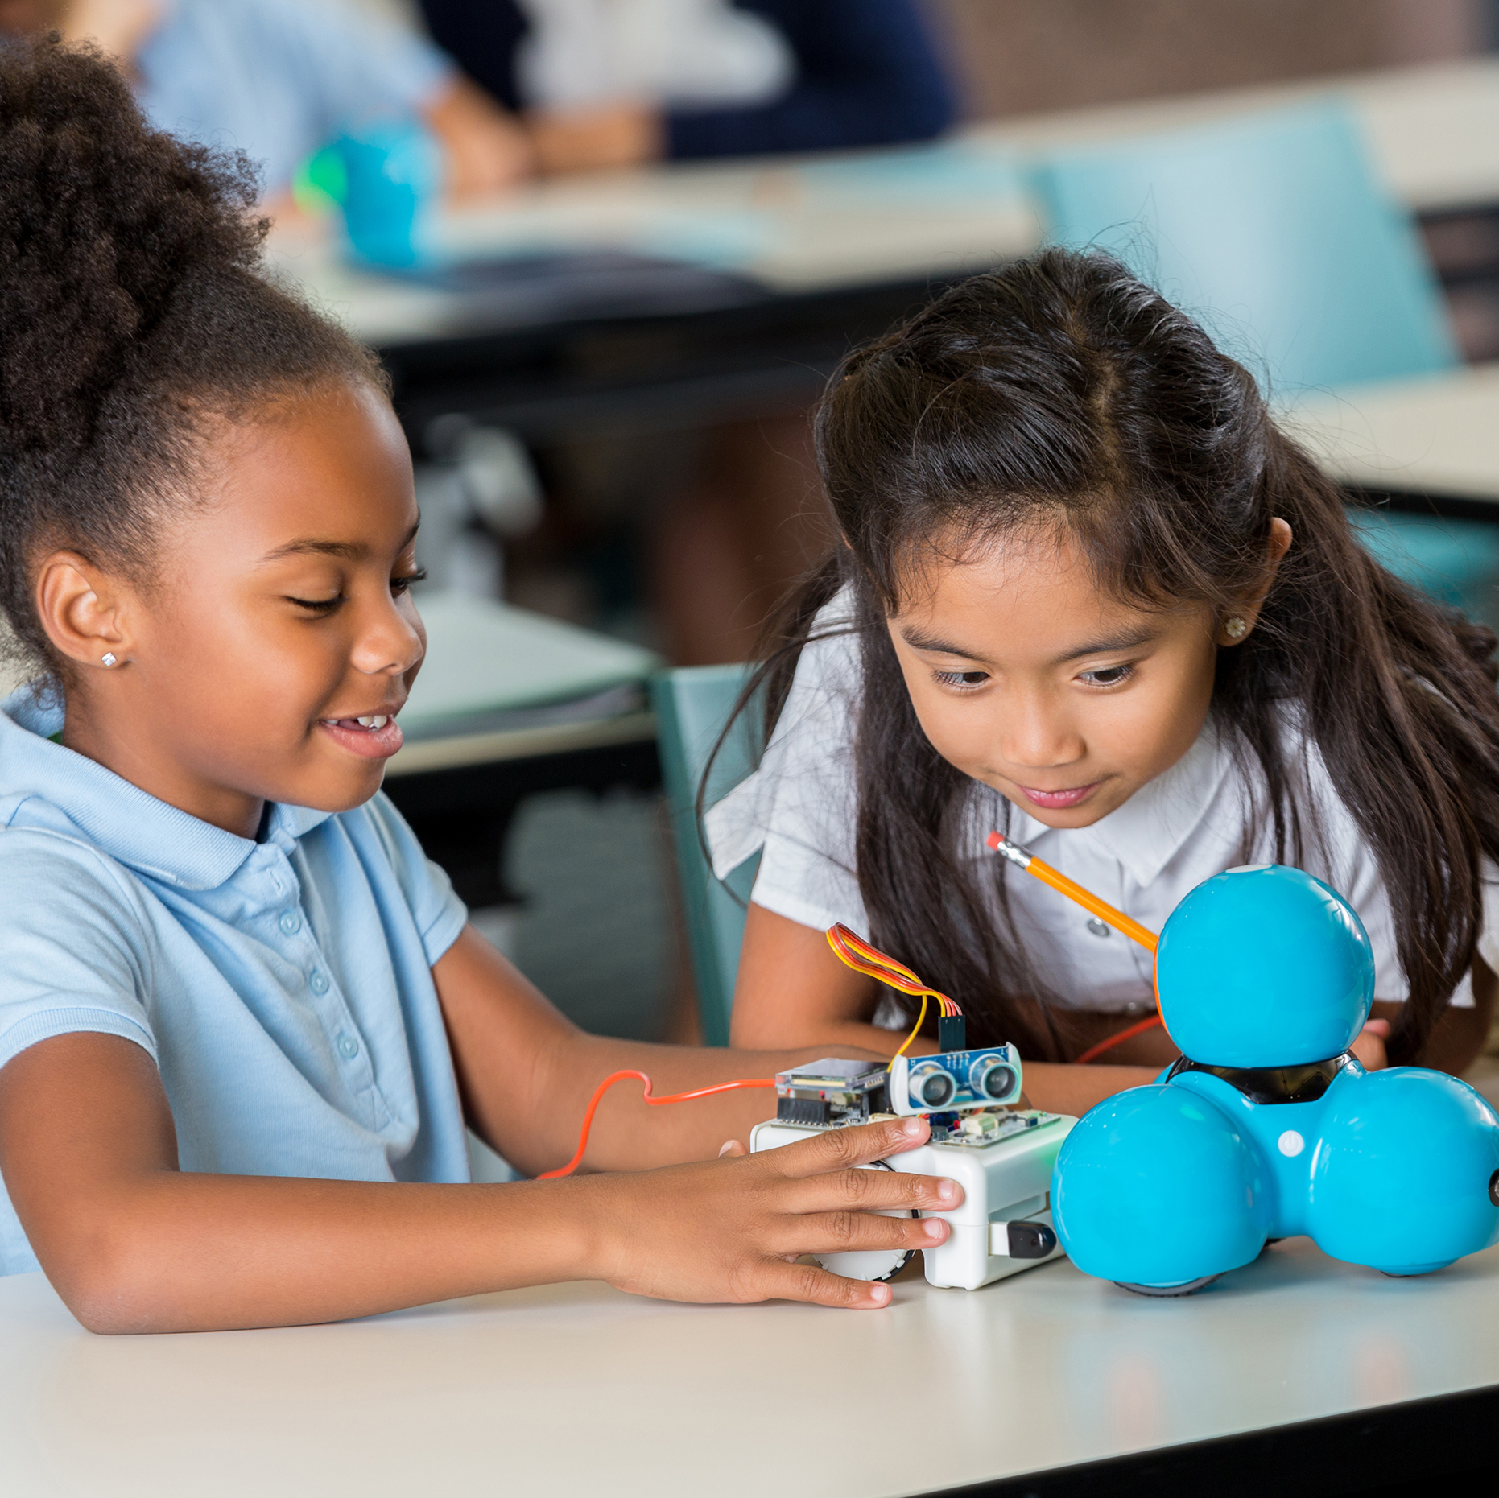

Step 2: Technology

Slide 7

Label
Silver Award
Step 2: Technology
Provide evidence for one example of the learners using technology for any subject and label clearly. By technology we are referring to the use of Information Communications Technologies (ICT), coding or robotics.
Notes:
Provide evidence for one example of how the learners used technology as part of their school work. By technology we are referring to the use of Information Communications Technologies (ICT), coding or robotics (see list below).
Examples can include:
• Record and analyse data collected e.g. a spreadsheet or graph.
• Learners develop a blog, website or video.
• Use electronic components to build simple circuits.
• Take part in coding and computer science initiatives: National Scratch Competition, Hour of Code, EU Code Week, or coding and robotics workshops.
• Explore robotics e.g, First Lego League.
• Engage pupils in the use of gamebased learning such as Minecraft.
• Participate in Tech Week in March.
Note: The above must be carried out by learners. The use of technology by teachers (e.g. use of PowerPoint, ICT, development of blogs or video) do not count for this step of the Award.

Slide 8
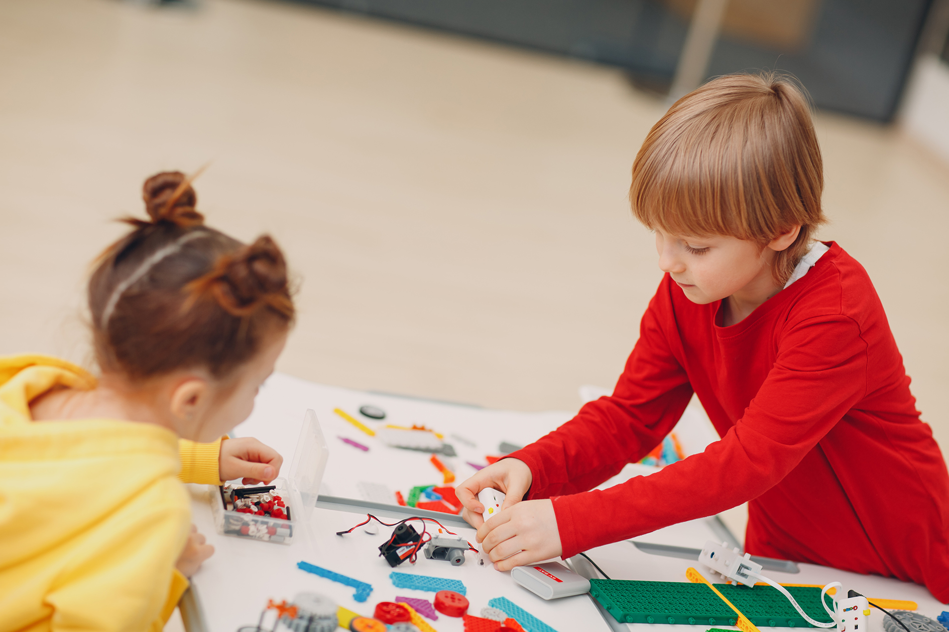
Step 3: Engineering

Slide 9
Silver Award
Step 3: Engineering
Provide evidence for one example of how the learners investigated engineering in class or in the local area and label clearly.
Label
Notes:
Provide evidence for one example of how the learners investigated engineering in class or in the local area.
Examples can include:
• Design and make activities e.g. making models (exploring, planning, designing, making, evaluating). For sample activities including design a bridge, a boat, a rocket, a water pump, a catapult, see the ‘classroom activities’ section of www.curiousminds.ie.
• Digital investigations of engineering (e.g. using Google Maps, online research and project creation) are accepted.
• Investigate and develop an understanding of how everyday items work e.g. bicycle gears.
• Organise an event during Engineers Week, like a simple design challenge
in the classroom or at home or use the Engineers Week classroom pack www.engineersweek.ie.
• Participate in the STEPS Young Engineers Award.
• Explore renewable energy technologies e.g. Use solar energy kits.

Slide 10

Step 4: Maths

Slide 11
Silver Award
Step 4: Maths
Provide evidence for one example of how the learners have applied their maths knowledge and skills in practical ways and label clearly.
Label
Notes:
Provide evidence for one example of how the learners have applied their Maths knowledge and skills in practical ways.
Examples can include:
• Children using Maths skills and knowledge as part of Science, Technology, Engineering/design and make, or other activities such as baking or gardening e.g. ordering, measuring distances, capacity, weight, recording and analysing data. Using Maths operations; ratio, percentages, averages.
• Use Maths to record and analyse your science investigation results where appropriate.
• Take part in Maths Week.
• Develop a Maths trail around our school, or for students to carry out at home.
• Use Maths in practical ways to help explore and solve real world problems.
• Take part in other maths focused activities e.g. Mathletes Challenge, Mangahigh or Maths Eyes.

Slide 12

Step 5: Show and Tell

Slide 13
Silver Award
Step 5: STEM Show and Tell
Provide evidence for one or more example of how the learners have presented and explained their STEM work to others (beyond their own class) and label clearly.
Label
Notes:
Provide evidence for one example of how the learners have presented and explained their STEM work to others (beyond their own class).
Examples can include:
• Evidence of students presenting their science work to others in the school or online e.g. digital Showcase over Zoom with parents/ grandparents/other classes.
• Hold an open day or evening online, where students present their STEM work to the school, parents or community.
• Take part in a joint online science event with another school.
• Take part in a science fair (live or online) where students present and discuss their STEM projects e.g. ESB Science Blast, Junior Lego League, BT Young Scientist.
Note: Written work / displays alone are not sufficient for this step.

