Slide 1

Curious minds award 2025/2026
Curious Minds Award 2025/26
Log of Evidence
Gold Award
Add School Name
Notes:
This Log of Evidence demonstrates that you have completed the work you’ve described in the application form and provides an account of the hands-on, STEM work carried out by learners in your school.
This year, your log of evidence must be presented using the SFI Curious Minds Log of Evidence Template.
Images or videos providing evidence of each activity should be added to the Log of Evidence Template, labelled and uploaded to the online application platform SESAME in PDF or PowerPoint format. The template slides can be edited in PowerPoint or Google Slides and additional slides may be added.
All evidence should represent the learners’ hands-on STEM work and include clearly labelled photos/ videos/projects/learner’s written accounts (Teacher write-ups and lesson plans are not accepted).
Note: Please check your application to ensure that all links and files are easily accessible and clearly labelled before submitting. We may return your application if it is not well organised or not clearly labelled.

Slide 2
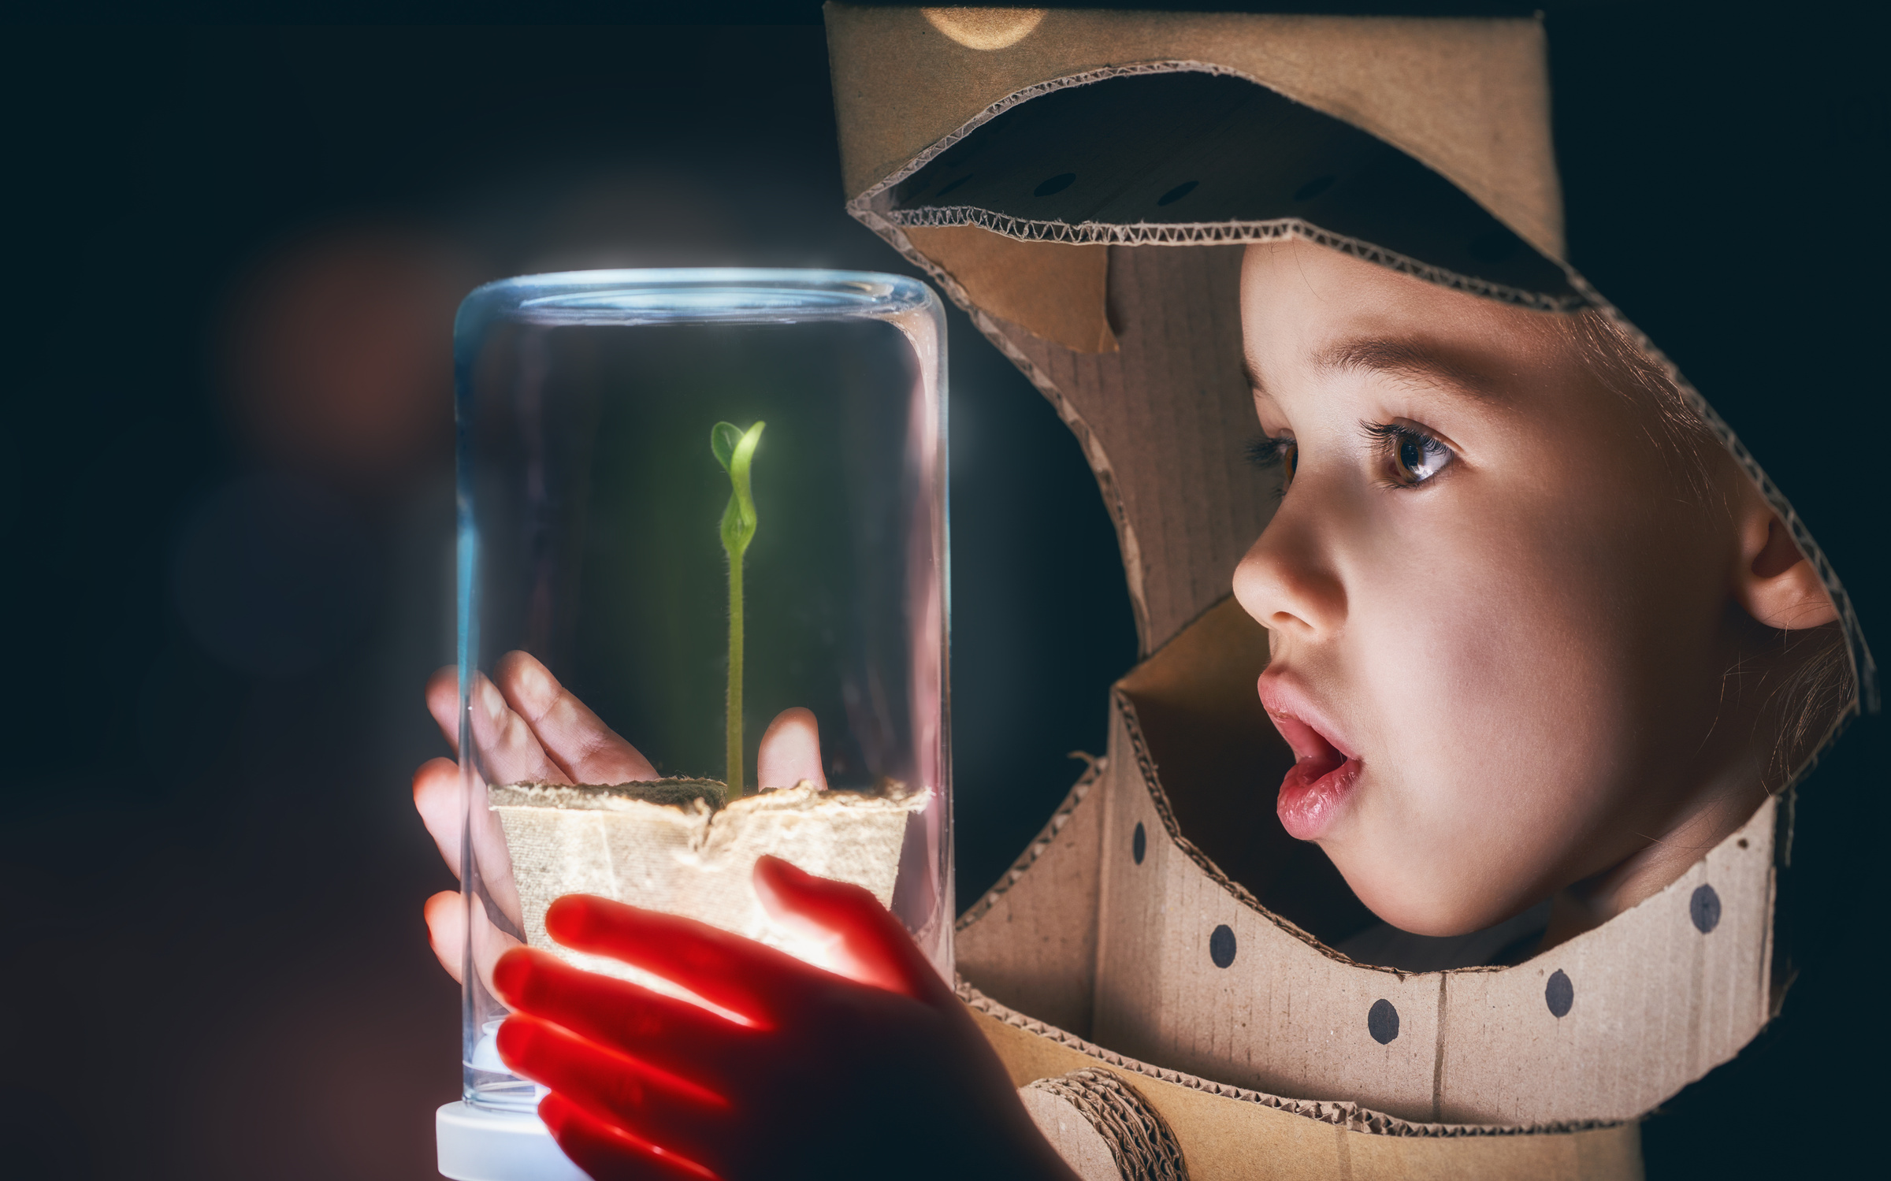

Step 1: Science
Notes:
STEP 1 Science
Provide evidence of the learners engaging in science activities in school or online.
One hands-on investigation from each of the four curriculum strands (four in total):
• Living things
• Energy and forces
• Materials
• Environmental awareness and care

Slide 3
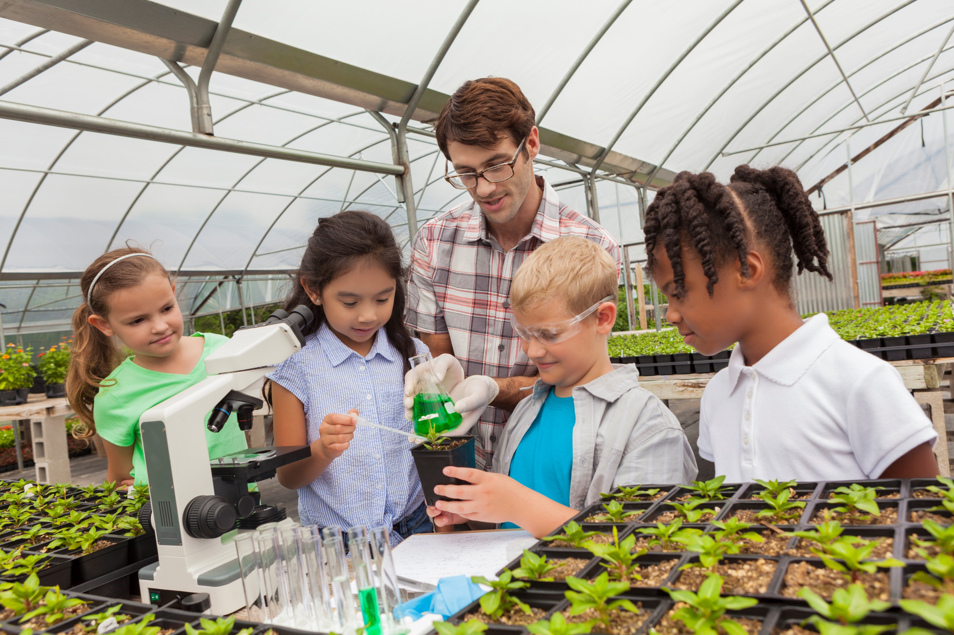
Living things
Gold Award
Step 1: Science
Living Things
Provide evidence (e.g. photos or videos) of student’s hands-on investigation for the Living Things strand and clearly label. Add new slides where appropriate.
Second Class learned how water moved through plants (transpiration) in the school vegetable garden
Notes:
You may come up with your own ideas, use the Curious Minds/ESERO resources on www.curiousminds.ie or www.esero.ie, or any other options that are available to you.

Slide 4

Energy and Forces
Gold Award
Step 1: Science
Provide evidence (e.g. photos or videos) of student’s hands-on investigation for the Energy and Forces strand and clearly label. Add new slides where appropriate.
Label
Notes:
You may come up with your own ideas, use the Curious Minds/ESERO resources on www.curiousminds.ie or www.esero.ie, or any other options that are available to you.

Slide 5
Materials
Gold Award
Step 1: Science
Provide evidence (e.g. photos or videos) of student’s hands-on investigation for the Materials strand and clearly label. Add new slides where appropriate.
Label
Notes:
You may come up with your own ideas, use the Curious Minds/ESERO resources on www.curiousminds.ie or www.esero.ie, or any other options that are available to you.

Slide 6

Environmental Awareness and Care
Gold Award
Step 1: Science
Provide evidence (e.g. photos or videos) of student’s hands-on investigation for the Environmental Awareness and Care strand and clearly label. Add new slides where appropriate.
Label
Notes:
You may come up with your own ideas, use the Curious Minds/ESERO resources on www.curiousminds.ie or www.esero.ie, or any other options that are available to you.

Slide 7

Science Activity 1
Gold Award
Step 1: Science
Provide evidence (e.g. photos or video) for the first of two science activities that the school participated in. Please label clearly.
Label
Notes:
Provide evidence of informal science activities from the list below:
• Participate in science events or projects run by other organisations (live or online), see examples at www.sfi.ie/events on www.curiousminds.ie.
• Invite a science speaker to your school, in person or digitally. Check out Skype a Scientist.
• Virtual or in-person visit to an SFI Discover Centre. Check www.curiousminds.ie.
• Take part in Science Week www.scienceweek.ie.
• Take part in Space Week www.spaceweek.ie.
• Show how pupils have used STEM skills in projects on environment or sustainability. (see www.seai.ie/teaching-sustainability/primary-school or www.greenschoolsireland.org for ideas).

Slide 8
Science activity 2
Gold Award
Step 1: Science
Science Activity 2
Provide evidence (e.g. photos or video) for the second of two science activities that the school participated in. Please label clearly.
Label
Notes:
Provide evidence of informal science activities from the list below:
• Participate in science events or projects run by other organisations (live or online), see examples at www.sfi.ie/events on www.curiousminds.ie.
• Invite a science speaker to your school, in person or digitally. Check out Skype a Scientist.
• Virtual or in-person visit to an SFI Discover Centre. Check www.curiousminds.ie.
• Take part in Science Week www.scienceweek.ie.
• Take part in Space Week www.spaceweek.ie.
• Show how pupils have used STEM skills in projects on environment or sustainability. (see www.seai.ie/teaching-sustainability/primary-school or www.greenschoolsireland.org for ideas).

Slide 9
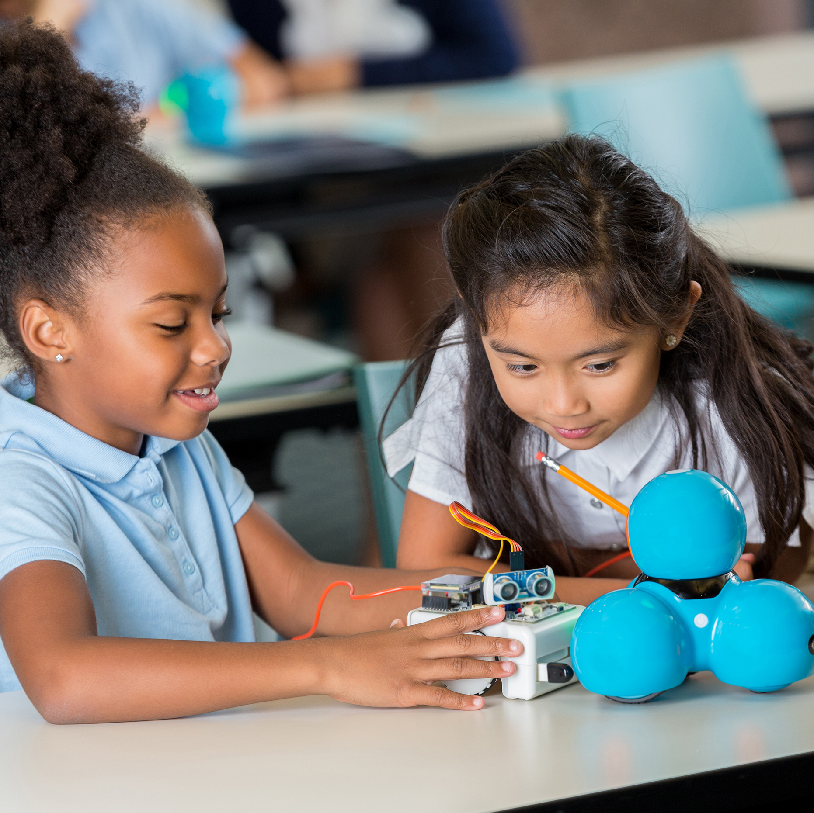

Step 2: Technology
Notes:
Provide evidence for two or more examples of how the learners used technology as part of their schoolwork. By technology we are referring to the use of Information Communications Technologies (ICT), coding or robotics (see list above).
Examples can include:
• Record and analyse data collected e.g. a spreadsheet or graph.
• Develop a blog, website or video.
• Use electronic components to build simple circuits.
•Take part in coding and computer science projects: National Scratch Competition, Hour of Code, EU Code Week, or coding and robotics workshops offered by SFI Discover Centres or other organisations e.g. Dream Space.
• Explore robotics e.g. FIRST® LEGO® League.
• Engage pupils in the use of game-based learning such as Minecraft.
• Explore renewable energy technologies e.g. use solar energy kits.
Note: The above must be carried out by learners. The use of technology by teachers (e.g. use of PowerPoint, ICT, development of blogs or video) do not count for this step of the Award.
Link to: https://www.sfi.ie/engagement/curious-minds/discover-centres/

Slide 10
First Activity
Gold Award
Step 2: Technology
Provide evidence for the first example of the learners using technology for any subject and label clearly. By technology we are referring to the use of Information Communications Technologies (ICT), coding or robotics.
Label
Notes:
Provide evidence for two or more examples of how the learners used technology as part of their schoolwork. By technology we are referring to the use of Information Communications Technologies (ICT), coding or robotics (see list above).
Examples can include:
• Record and analyse data collected e.g. a spreadsheet or graph.
• Develop a blog, website or video.
• Use electronic components to build simple circuits.
•Take part in coding and computer science projects: National Scratch Competition, Hour of Code, EU Code Week, or coding and robotics workshops offered by SFI Discover Centres or other organisations e.g. Dream Space.
• Explore robotics e.g. FIRST® LEGO® League.
• Engage pupils in the use of game-based learning such as Minecraft.
• Explore renewable energy technologies e.g. use solar energy kits.
Note: The above must be carried out by learners. The use of technology by teachers (e.g. use of PowerPoint, ICT, development of blogs or video) do not count for this step of the Award.
Link to: https://www.sfi.ie/engagement/curious-minds/discover-centres/

Slide 11
Second Activity
Gold Award
Step 2: Technology
Provide evidence for the second example of the learners using technology for any subject and label clearly. By technology we are referring to the use of Information Communications Technologies (ICT), coding or robotics.
Label
Notes:
Provide evidence for two or more examples of how the learners used technology as part of their schoolwork. By technology we are referring to the use of Information Communications Technologies (ICT), coding or robotics (see list above).
Examples can include:
• Record and analyse data collected e.g. a spreadsheet or graph.
• Develop a blog, website or video.
• Use electronic components to build simple circuits.
•Take part in coding and computer science projects: National Scratch Competition, Hour of Code, EU Code Week, or coding and robotics workshops offered by SFI Discover Centres or other organisations e.g. Dream Space.
• Explore robotics e.g. FIRST® LEGO® League.
• Engage pupils in the use of game-based learning such as Minecraft.
• Explore renewable energy technologies e.g. use solar energy kits.
Note: The above must be carried out by learners. The use of technology by teachers (e.g. use of PowerPoint, ICT, development of blogs or video) do not count for this step of the Award.
Link to: https://www.sfi.ie/engagement/curious-minds/discover-centres/

Slide 12
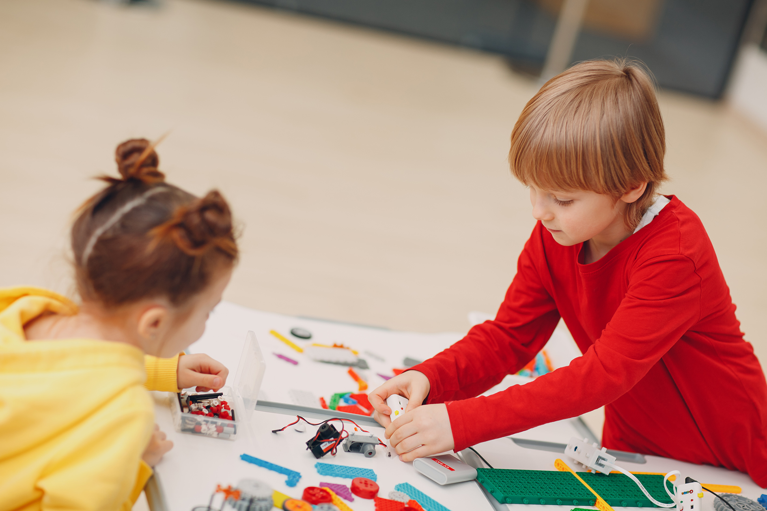
Step 3: Engineering
Notes:
Provide evidence for two or more examples of how the learners investigated engineering in class or in the local area. Video and photo evidence of at-home investigations are also accepted.
Examples can include:
• Design and make activities e.g. making models (exploring, planning, designing, making, evaluating). For sample activities including design a bridge, a boat, a rocket, a water pump, a catapult, see the ‘classroom activities’ section of www.curiousminds.ie.
• Digital investigations of engineering (e.g. using Google Maps, online research, and project creation) are accepted.
• Investigate and develop an understanding of how everyday items work (e.g. bicycle gears).
• Organise an event during Engineers Week or use the Engineers Week classroom pack www.engineersweek.ie.
• Participate in the STEPS Young Engineers Award.

Slide 13
Engineering First Activity
Gold Award
Step 3: Engineering
Provide evidence for the first example of how the learners investigated engineering in class or in the local area and label clearly.
Label
Notes:
Provide evidence for two or more examples of how the learners investigated engineering in class or in the local area. Video and photo evidence of at-home investigations are also accepted.
Examples can include:
• Design and make activities e.g. making models (exploring, planning, designing, making, evaluating). For sample activities including design a bridge, a boat, a rocket, a water pump, a catapult, see the ‘classroom activities’ section of www.curiousminds.ie.
• Digital investigations of engineering (e.g. using Google Maps, online research, and project creation) are accepted.
• Investigate and develop an understanding of how everyday items work (e.g. bicycle gears).
• Organise an event during Engineers Week or use the Engineers Week classroom pack www.engineersweek.ie.
• Participate in the STEPS Young Engineers Award.

Slide 14
Engineering Second Activity
Gold Award
Step 3: Engineering
Provide evidence for the second example of how the learners investigated engineering in class or in the local area and label clearly.
Label
Notes:
Provide evidence for two or more examples of how the learners investigated engineering in class or in the local area. Video and photo evidence of at-home investigations are also accepted.
Examples can include:
• Design and make activities e.g. making models (exploring, planning, designing, making, evaluating). For sample activities including design a bridge, a boat, a rocket, a water pump, a catapult, see the ‘classroom activities’ section of www.curiousminds.ie.
• Digital investigations of engineering (e.g. using Google Maps, online research, and project creation) are accepted.
• Investigate and develop an understanding of how everyday items work (e.g. bicycle gears).
• Organise an event during Engineers Week or use the Engineers Week classroom pack www.engineersweek.ie.
• Participate in the STEPS Young Engineers Award.

Slide 15

Step 4: Maths

Slide 16
Maths First Activity
Gold Award
Step 4: Maths
Provide evidence for the first example of how the learners have applied their maths knowledge and skills in practical ways and label clearly.
Label
Notes:
Provide evidence for two or more examples of how the learners have applied their maths knowledge and skills in practical ways.
Examples can include:
• Children using maths skills and knowledge as part of science, technology, engineering/design and make, or other activities such as baking or gardening e.g. ordering, measuring distances, capacity, weight, recording and analysing data. Using maths operations; ratio, percentages, averages.
• Use maths to record and analyse your science investigation results where appropriate.
• Take part in Maths Week.
• Develop a maths trail around your school, or for students to carry out at home.
• Use maths in practical ways to help explore and solve real world problems.
• Take part in other maths focused activities e.g. Mathletes Challenge, Mangahigh or Maths Eyes.

Slide 17
Maths Second Activity
Gold Award
Step 4: Maths
Provide evidence for the second example of how the learners have applied their maths knowledge and skills in practical ways and label clearly.
Label
Notes:
Provide evidence for two or more examples of how the learners have applied their maths knowledge and skills in practical ways.
Examples can include:
• Children using maths skills and knowledge as part of science, technology, engineering/design and make, or other activities such as baking or gardening e.g. ordering, measuring distances, capacity, weight, recording and analysing data. Using maths operations; ratio, percentages, averages.
• Use maths to record and analyse your science investigation results where appropriate.
• Take part in Maths Week.
• Develop a maths trail around your school, or for students to carry out at home.
• Use maths in practical ways to help explore and solve real world problems.
• Take part in other maths focused activities e.g. Mathletes Challenge, Mangahigh or Maths Eyes.

Slide 18

Step 5: Show and Tell
Notes:
STEP 1 Science
Provide evidence of the learners engaging in science activities in school or online.
One hands-on investigation from each of the four curriculum strands (four in total):
• Living things
• Energy and forces
• Materials
• Environmental awareness and care

Slide 19
STEM show and tell
Gold Award
Step 5: STEM Show and Tell
Provide evidence for one or more example of how the learners have presented and explained their STEM work to others (beyond their own class) and label clearly.
Label
Notes:
STEP 5 STEM Show and Tell
Provide evidence for one or more example of how the learners have presented and explained their STEM work to others (beyond their own class).
Examples can include:
• Evidence of students presenting their science work to others in the school or online e.g. digital showcase over Zoom with parents/grandparents/other classes.
• Take part in a science fair (live or online) where students present and discuss their STEM projects e.g. ESB Science Blast, Junior Lego League, BT Young Scientist.
• Participate in STEM Show and Tell initiatives such as the ReelLIFE Science video competition.
Note: Written work / displays alone are not sufficient for this step.

